Slide 1
S-98 Meeting 5th February 2026

Slide 2
Agenda
Introductions
S-98
Review Copy v2.5.0 Production
Timeline to HSSC
Release Notes: Summary of Changes and Existing Gaps
Q&A
S-164 Update
Progress and way forward
AOB
Next meeting(s)?

Slide 3
Timescales
2.5.5 has been sent out for formal review. Some comments already received ☺
14th Feb (actually, 16th) – end of review and aggregation of comments
Comment adjudication up to March 17th
= Version 2.6.0 [in Github now]
TSM (March 17th onward) to adjudicate any remaining comments and significant issues.
= Version 2.7.0
Post TSM version to be submitted to HSSC for approval as v3.0.0
= Version 2.8.0
Suggestion is to continue meetings throughout that time to assist implementers, answer questions and assess comments received to date.

Slide 4
S-101 and S-98
Is there anything else in the S-101 product specification that needs to be in S-98, anything for which a requirement needs to be placed on the implementer?
S-101 test datasets, functionality which isn’t an explicit “requirement”
Initial search from Chair S-101PT produced. Will be reviewed.

Slide 5
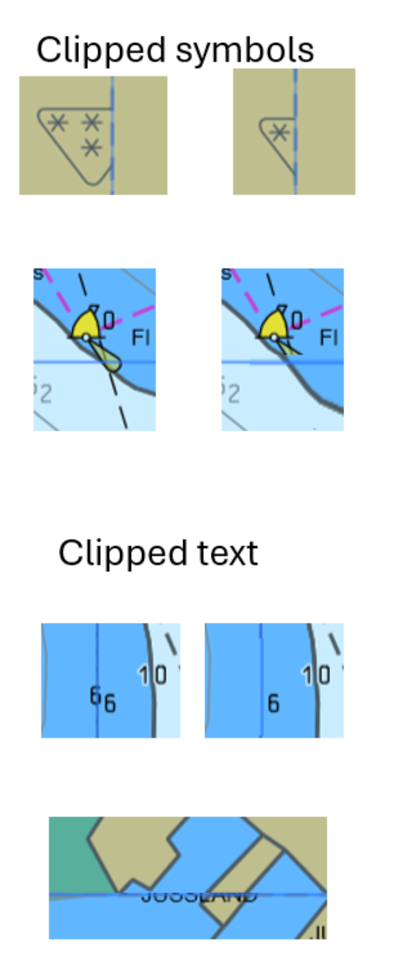
Issues
New issue on clipped symbols. Not covered by algorithm currently.
https://github.com/iho-ohi/98-interoperability/issues/73
Could a statement about OEMs ensuring symbols aren’t clipped be inserted?
Test data would then help implementers.
Other Issues:
Some dependencies on other PTs
Most will be documented and closed during redraft
Comment review period can cover outstanding issues.

Slide 6
Release Notes: Summary of Changes

Slide 7
Key Changes from v2.4.0
Version updated to 2.5.0 for S100WG review
New S-124 integration with 12-month NW expiry on ECDIS (unless retained by user)
Added detailed description of WLA / Vertical Uncertainty calculation
Corrected WLA diagram interval (was 15 minutes, should be 30 minutes)
New SSE code for fileless cancellations with invalid signatures + Flow diagram for fileless cancellation implementation added. Implies Data Producer signatures will be stored by the ECDIS
Editorial changes accepted from 2025 review comments
Changed Pick Report interoperabilityIdentifier as per last meeting

Slide 8
New Data Constraints Annex
Contains requirements for Data Producers (not OEMs)
Replicates content from S-98 which deals with data producer requirements. S-98 content left in for context (could be taken out?)
Profile of S-100 Part 10b GML constraining geometry structures
Simplified point, curve and surface. Fixed GML elements for each.
PosList and Pos coordinates only.
Fits with CATALOG.XML geometry already embedded in S-98 Annex C
Already Proposed:
Removal of: referenced geometry, ArcByCentrePoint, CircleByCentrePoint
Aim is to update independently of main S-98 document (without adding new OEM requirements)
Keeps OEM requirements stable while allowing Data Producer consensus and development over best ways of optimising data behaviour on ECDIS.
Outstanding list of items to be addressed by product specifications should be compiled, some for S-101 already.

Slide 9
Areas of Uncertainty

Slide 10
Safety Contour and Indications
Safety contour algorithm boundary behavior needs specification. Mandatory portrayal of safety contour edge needs refinement. Would avoid extraneous safety contour edges at dataset boundaries
Scale minimum indication requirement unclear (other categories covered)
Vertical Datum & Heights
Height/clearance value adjustment not currently possible
S-101 lacks sufficient vertical datum attribution
Requires S-101PT development
Should S-98 anticipate or discount such calculations?

Slide 11

Product Specification Support
Min-max number of product specifications not explicitly specified
HSSC level discussion with IHO Sec ongoing
De facto max could be 4? (based on S-164 tests)
No guidance for integrating multiple portrayal catalogues in single UI
No explicit statement that IHO won't remove IMO minimum standard elements
Dataset Loading & Import
Section 6.1.1 behavior for non-ENC overlays needs clarification (suggested, import, display, turn on/off, interrogate)
DataCoverage selection defined but no guidance on avoiding boundary clipping of features.
New S-164 tests being created to mitigate risks. May need other words in S-98

Slide 12
Digital Signatures & Certificates
Expired certificates for dataset import not yet implemented
All digital signatures must be valid requirement pending
Data Producer signatures must be present for all datasets (in existing text, also required for fileless cancellations)
Section 8.1 restrictions on non-ENC data import and overlays proposed but no consensus (yet). “What overlays what?” – WEND meeting upcoming.
Other
Updates to system support files

Slide 13
S-164 Progress
NIPWG formal review of S-122, S-123, S-127 and S-131 has commenced. Review to coincide with TSM, and feed into HSSC. NCWG review has also commenced on the portrayal approach for the four product specifications
New datasets have been uploaded to the S-164 github repository, dual fuel, all products, updates etc..
Manual in progress. New tests being drafted
Circulate for review – aiming at Friday 13th for discussion at TSM. Datatsets to follow.

Slide 14
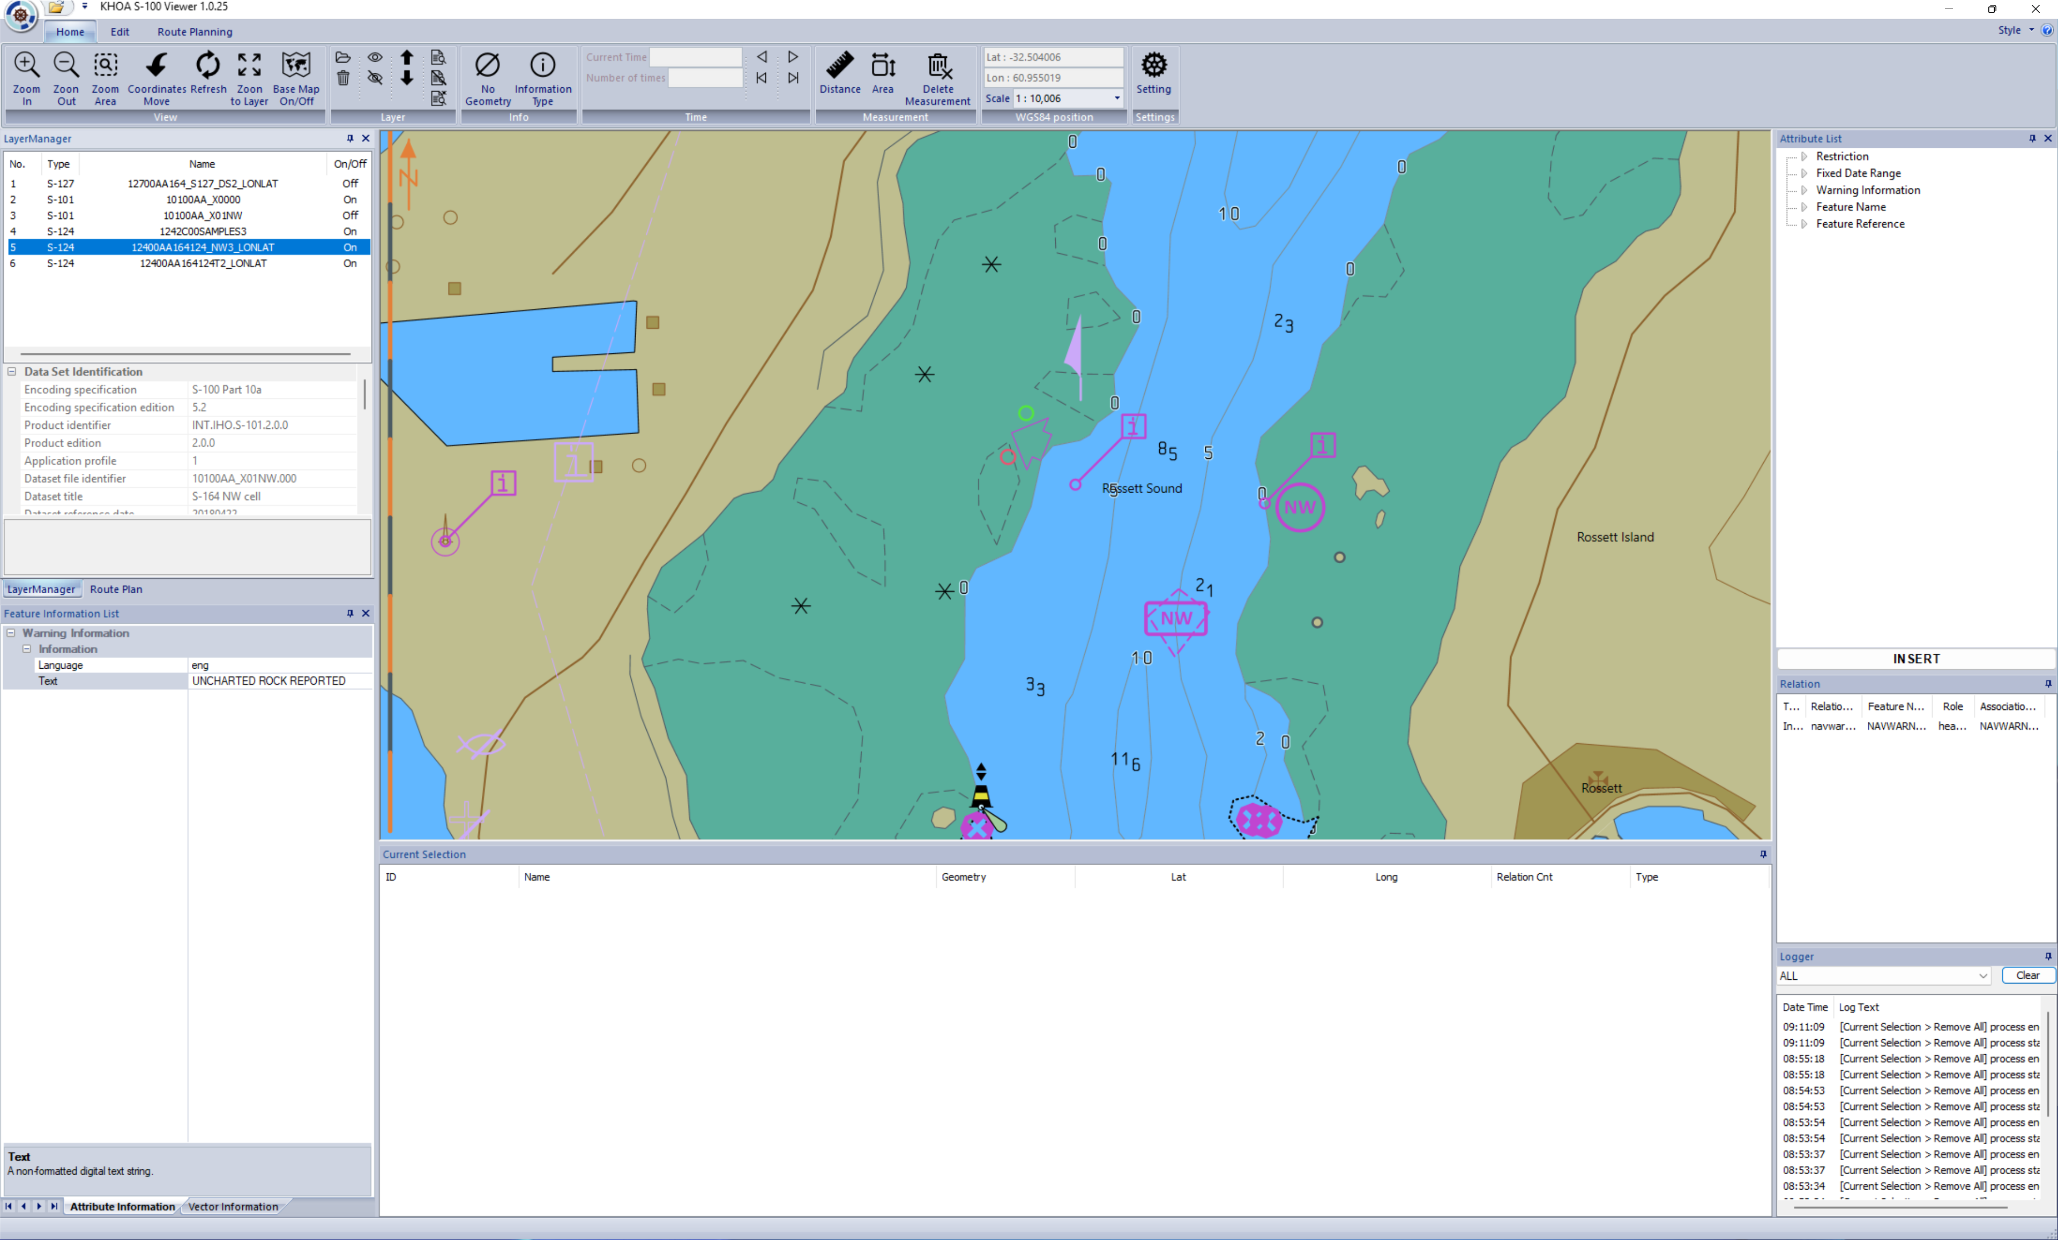
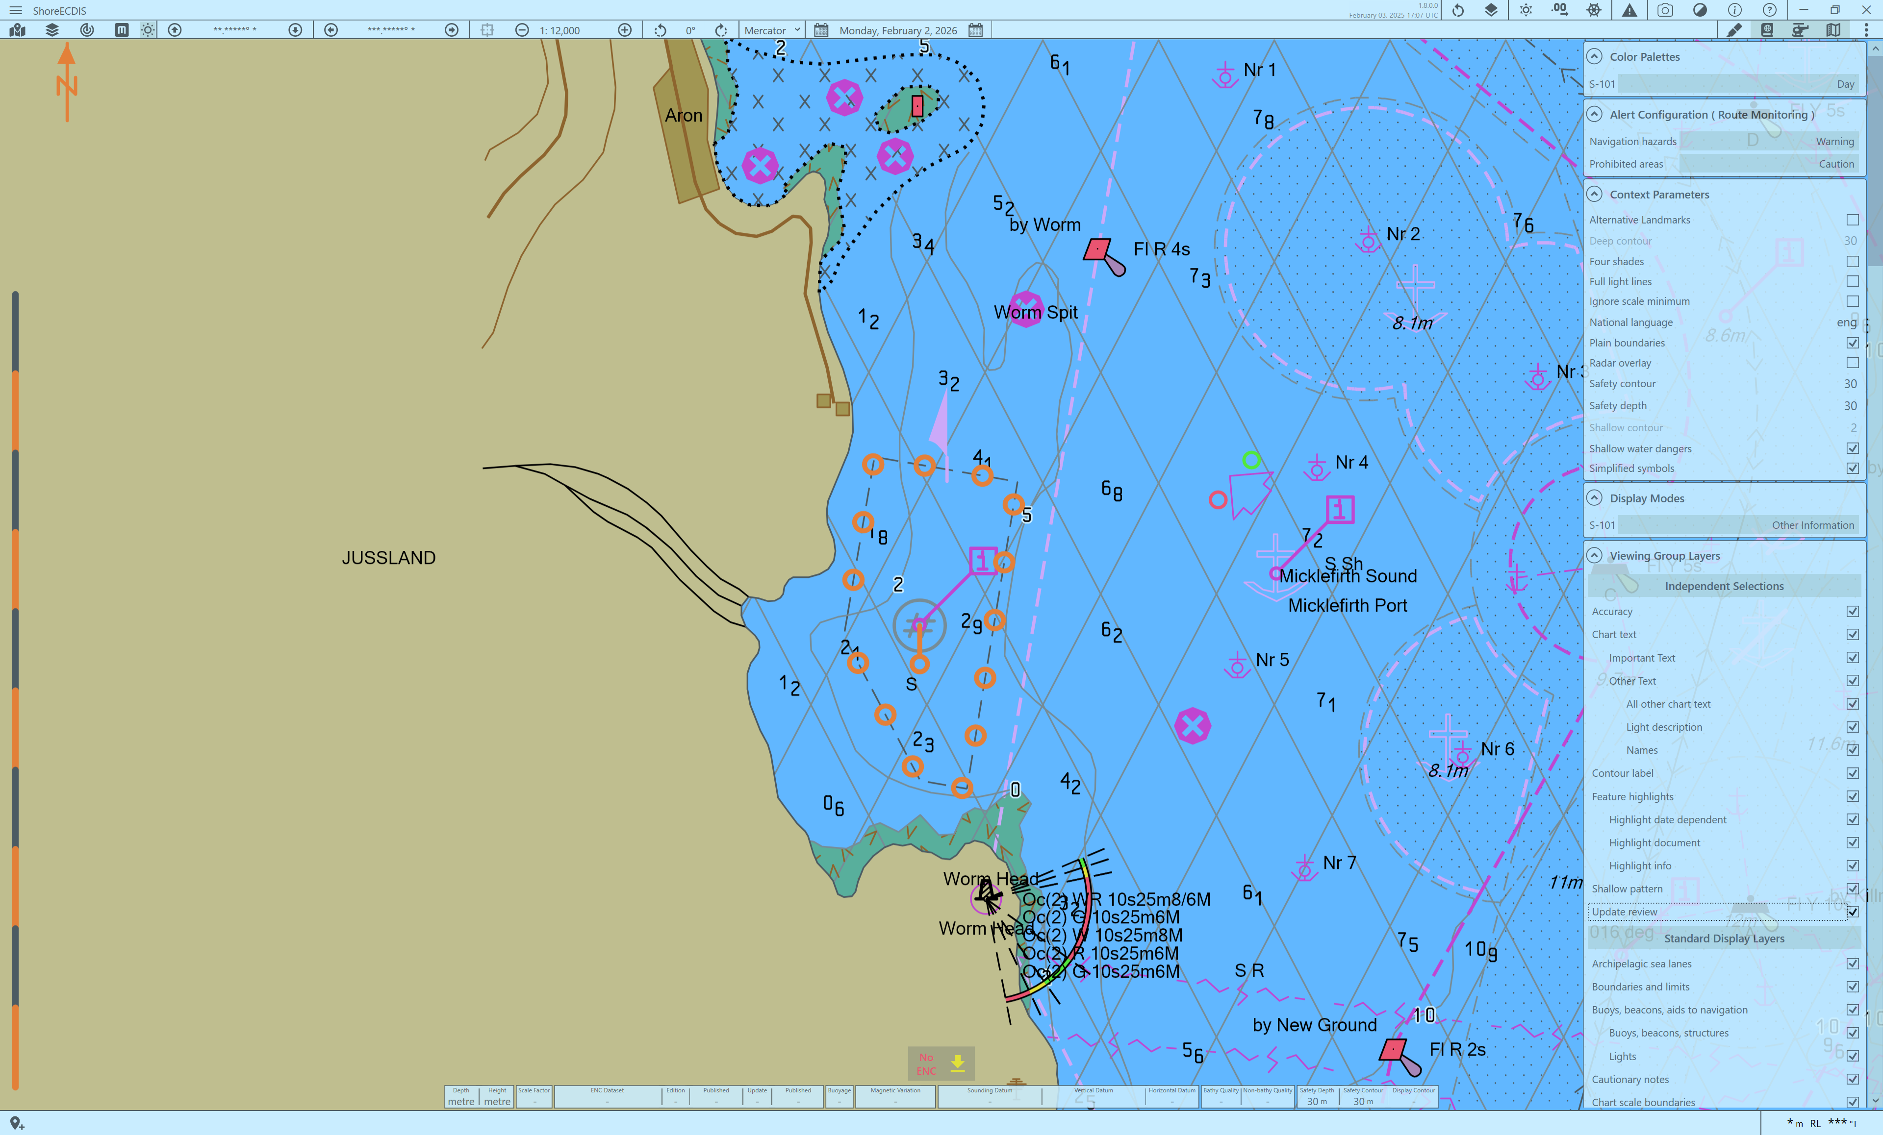
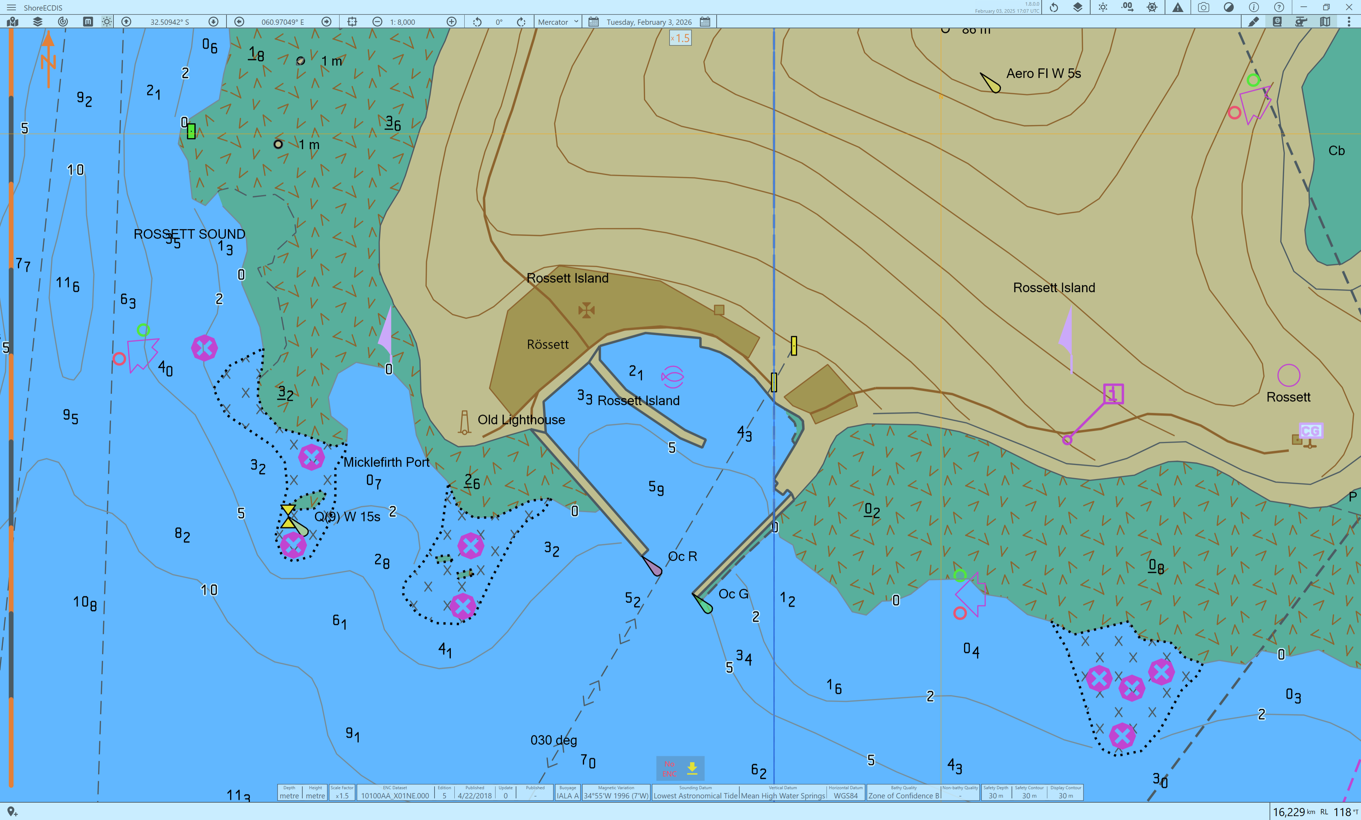
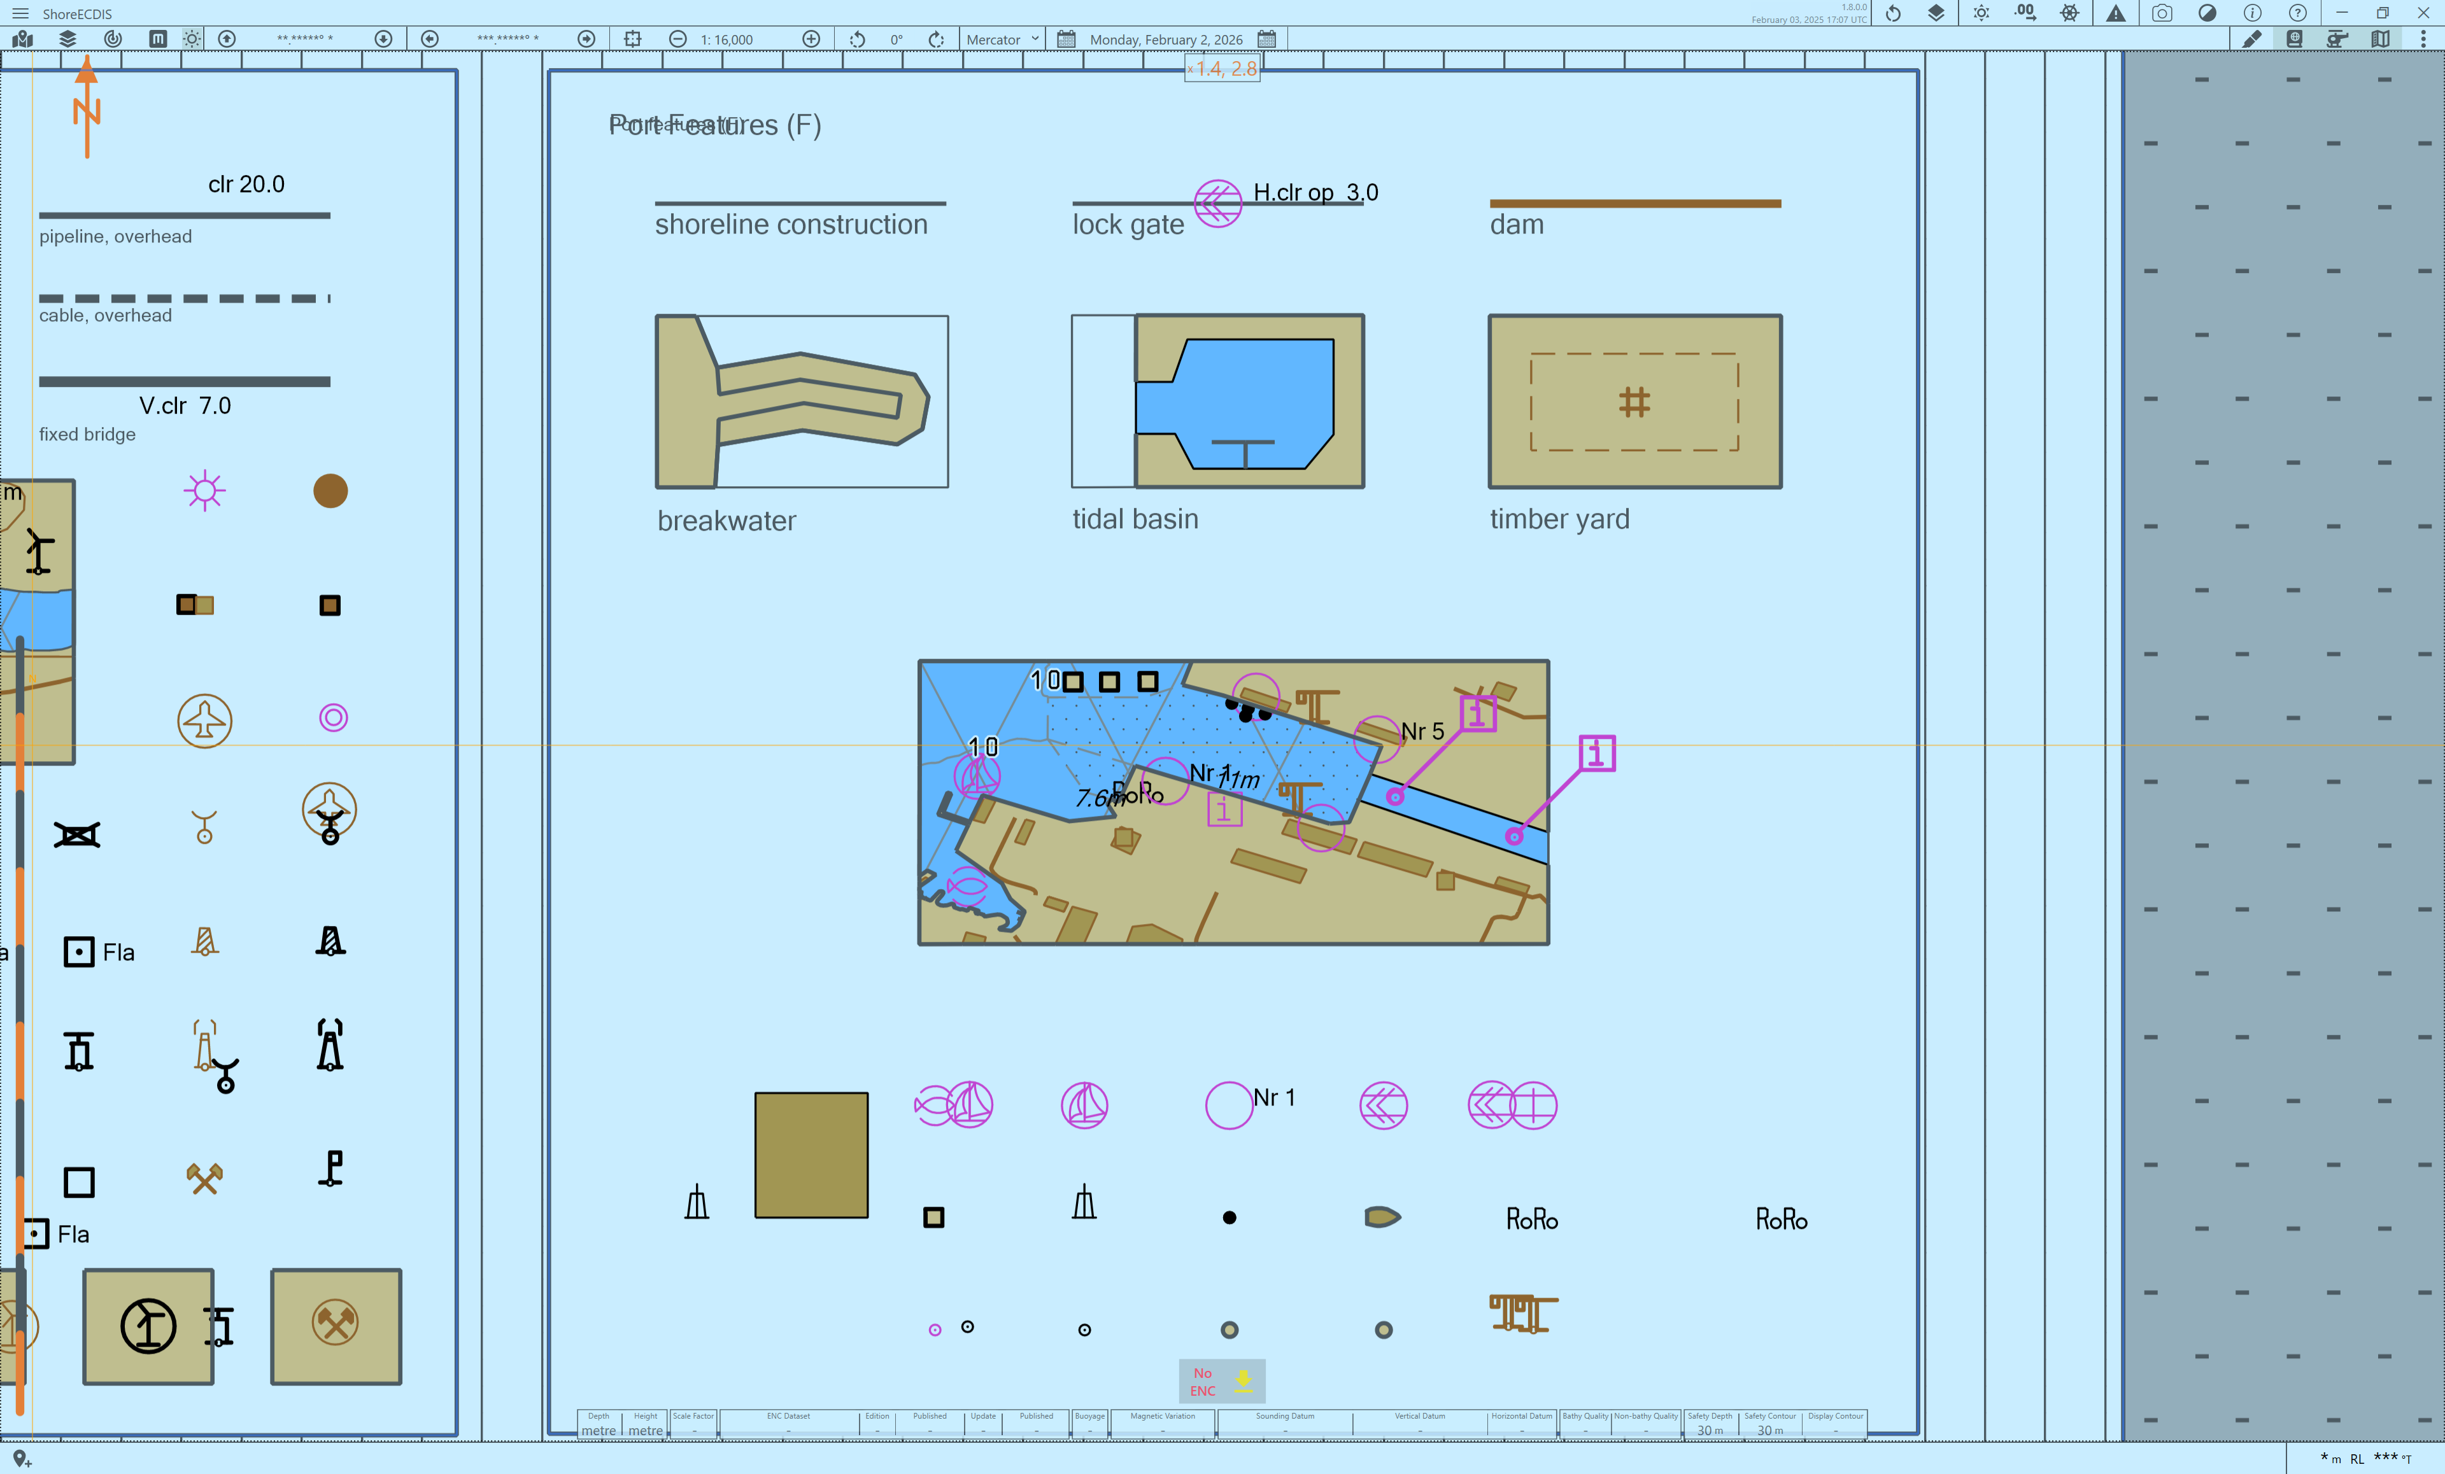
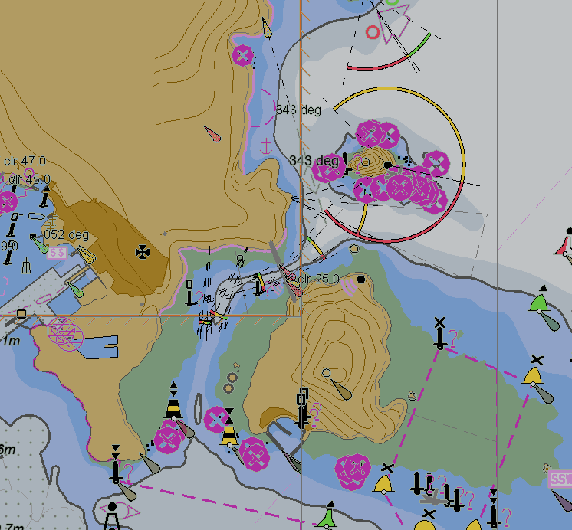
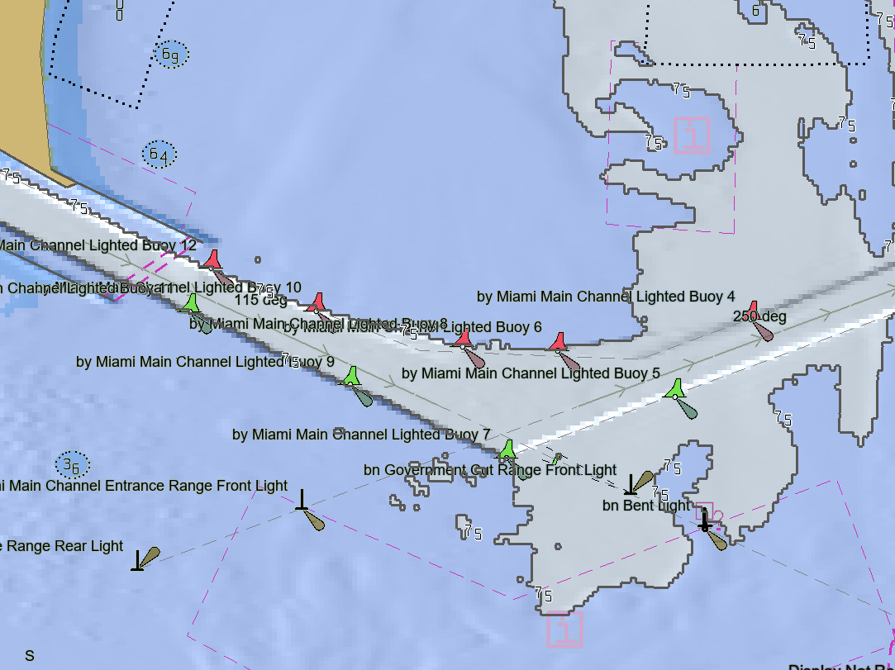
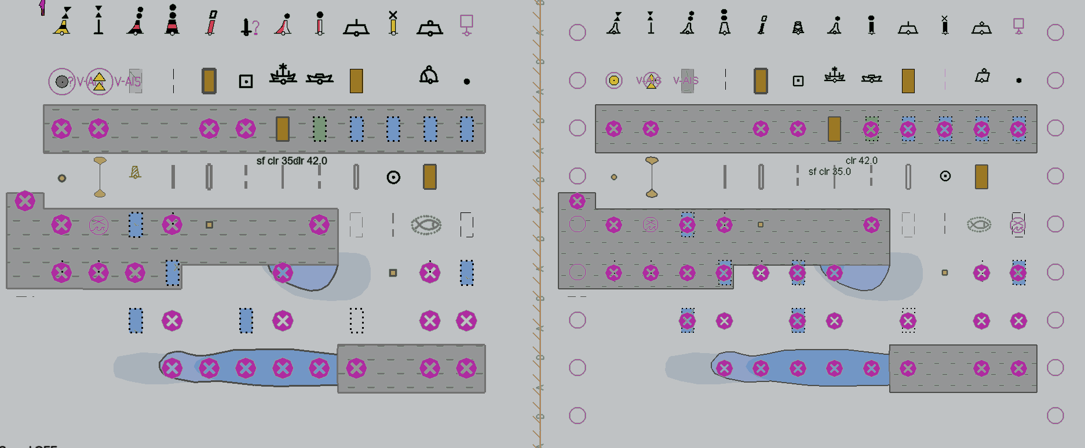
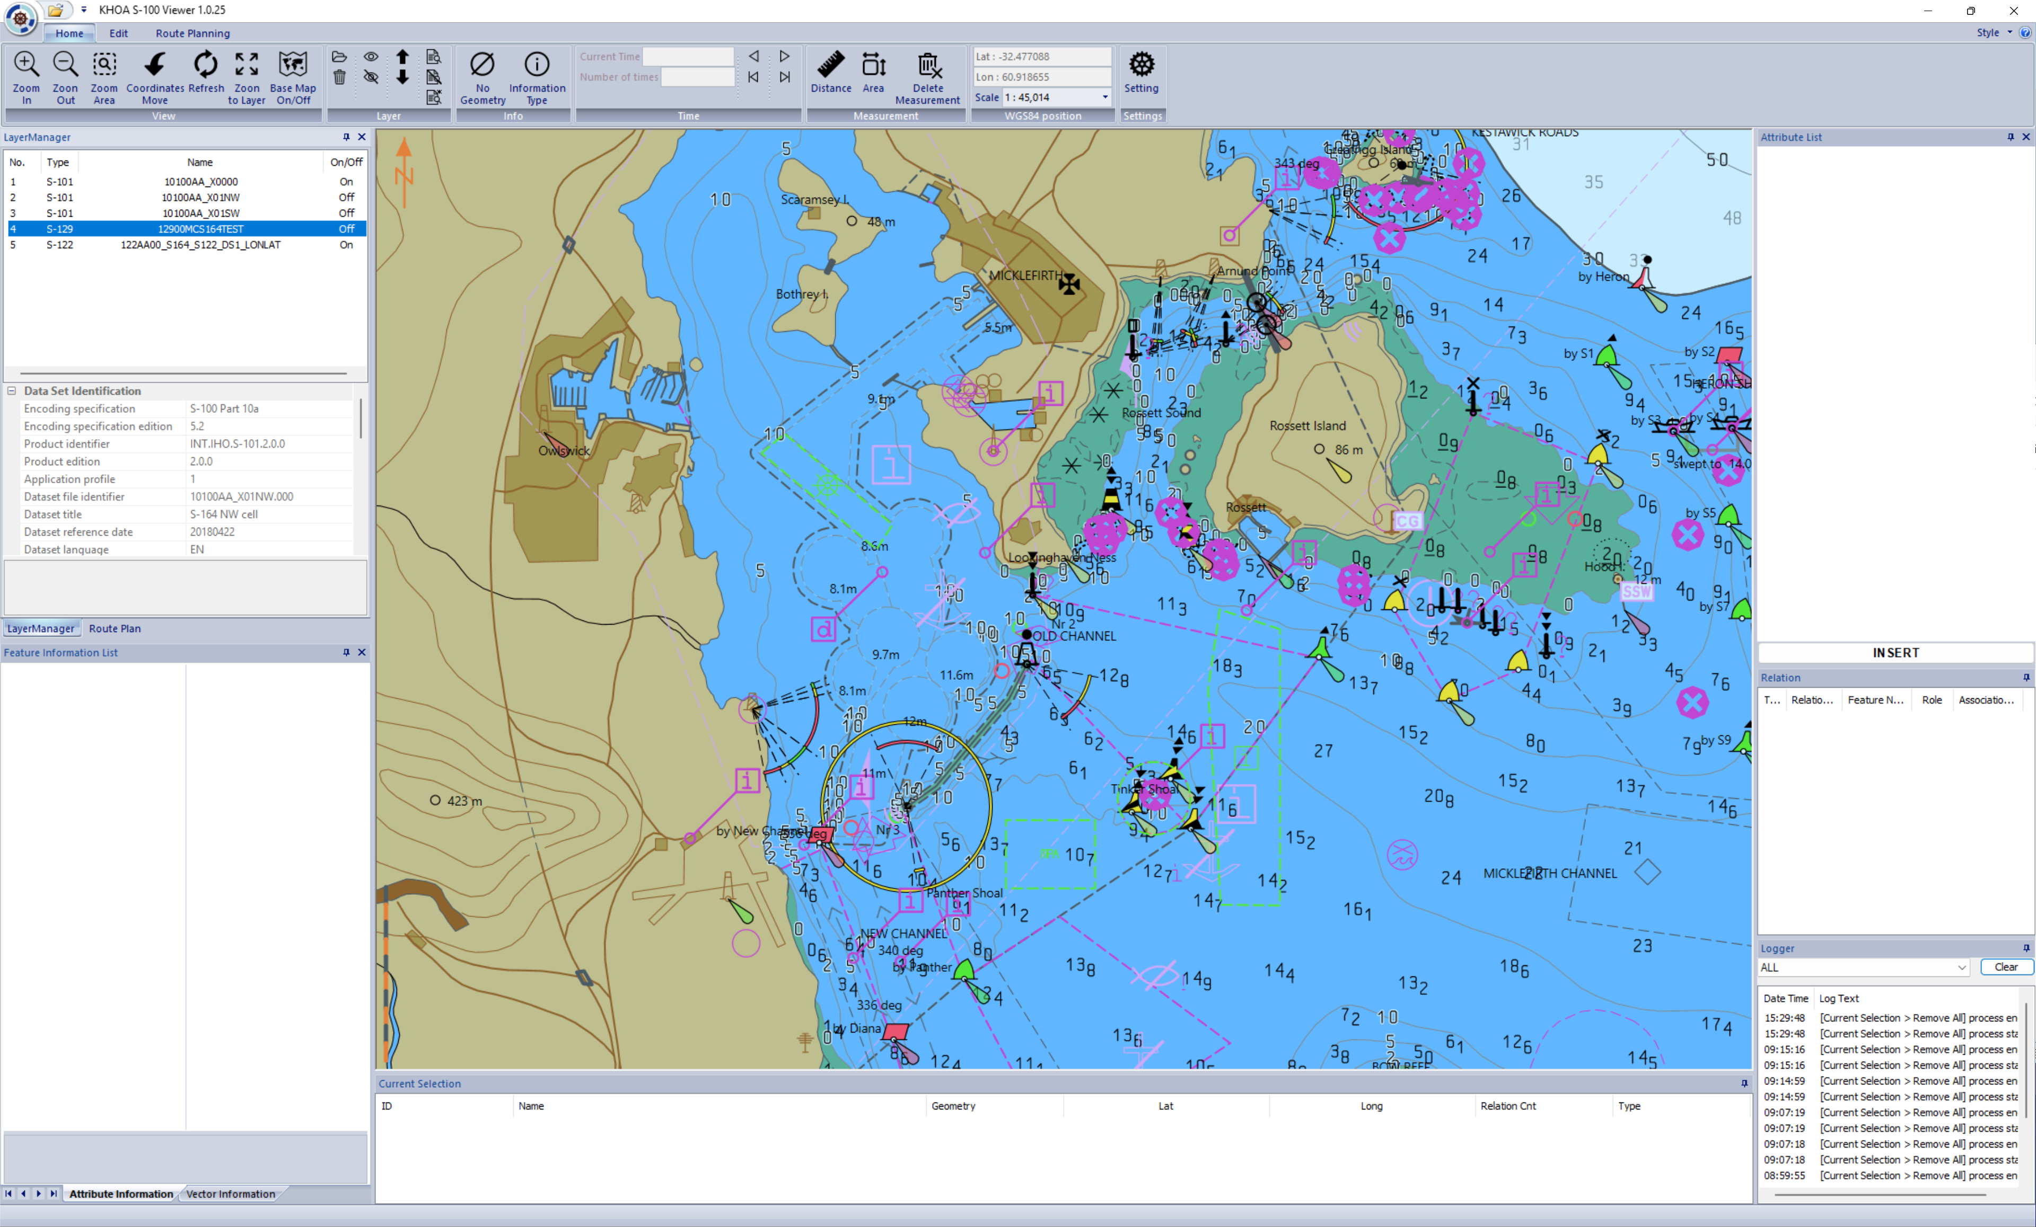
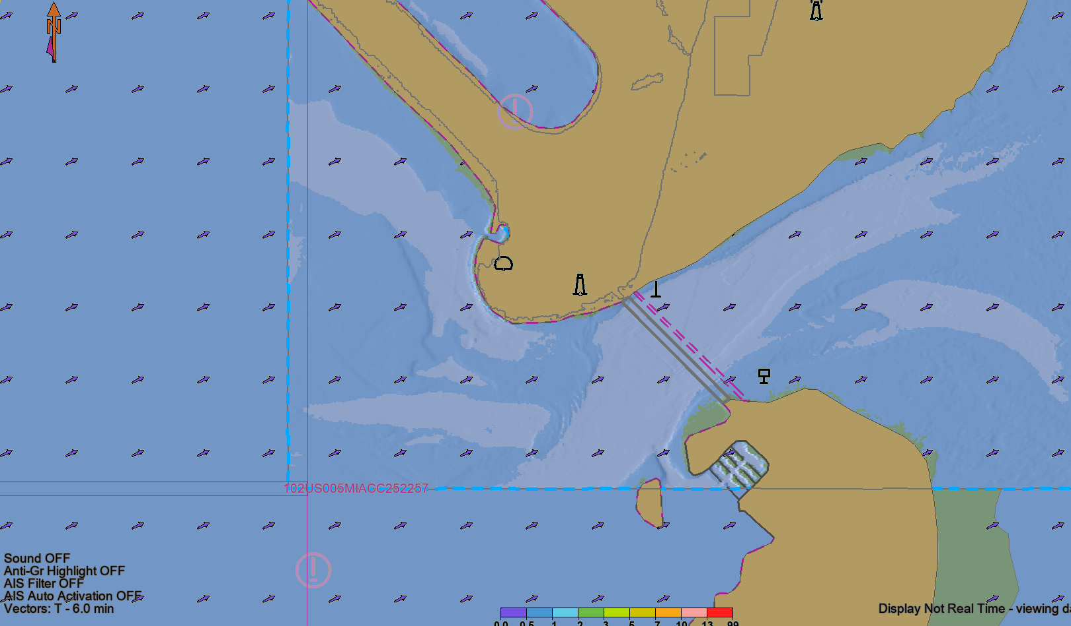
S-124
updateInformation
Preferred Languages
Chart 1
Dual Fuel - Hazards
S-102/S-104, S-111
Dual Fuel
S-122, S-123, S-127, S-131

Slide 15
Next Meeting(s)
Comment Adjudication for S-98 from 14th Feb onwards
Prior to TSM 17th – 20th March, a consolidated list of final issues to be compiled for resolution at meeting. TSM will also take issues arising out of reviews of S-164
Room for two meetings for adjudication w/b 2nd and 9th March depending on volume and nature of comments received
Happy to discuss areas of concern around these dates as well

